Slide 1

A Hybrid Approach for Real-Time
Parametric Facial Expression Animation
学生：李冰川
导师：姚俊峰
时间：20240109

Slide 2
1
Research Background
2
Method
3
Experiments

Slide 3
1
Research Background

Slide 4
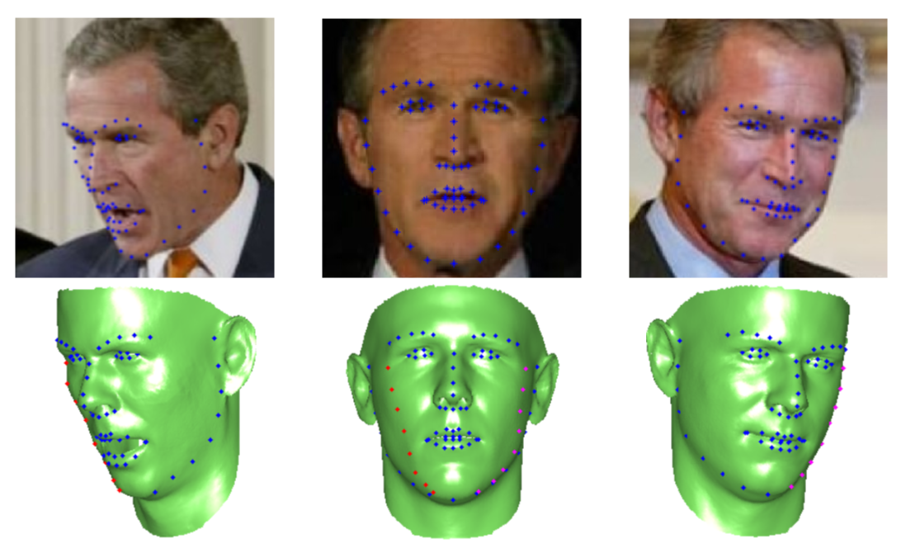
1 Research Background
3D Face Reconstruction from a Single Image.
Notes:
The topic of our study is Facial Expression Animation.
Facial expression animation is typically achieved through the method of single-image facial modeling.

Slide 5
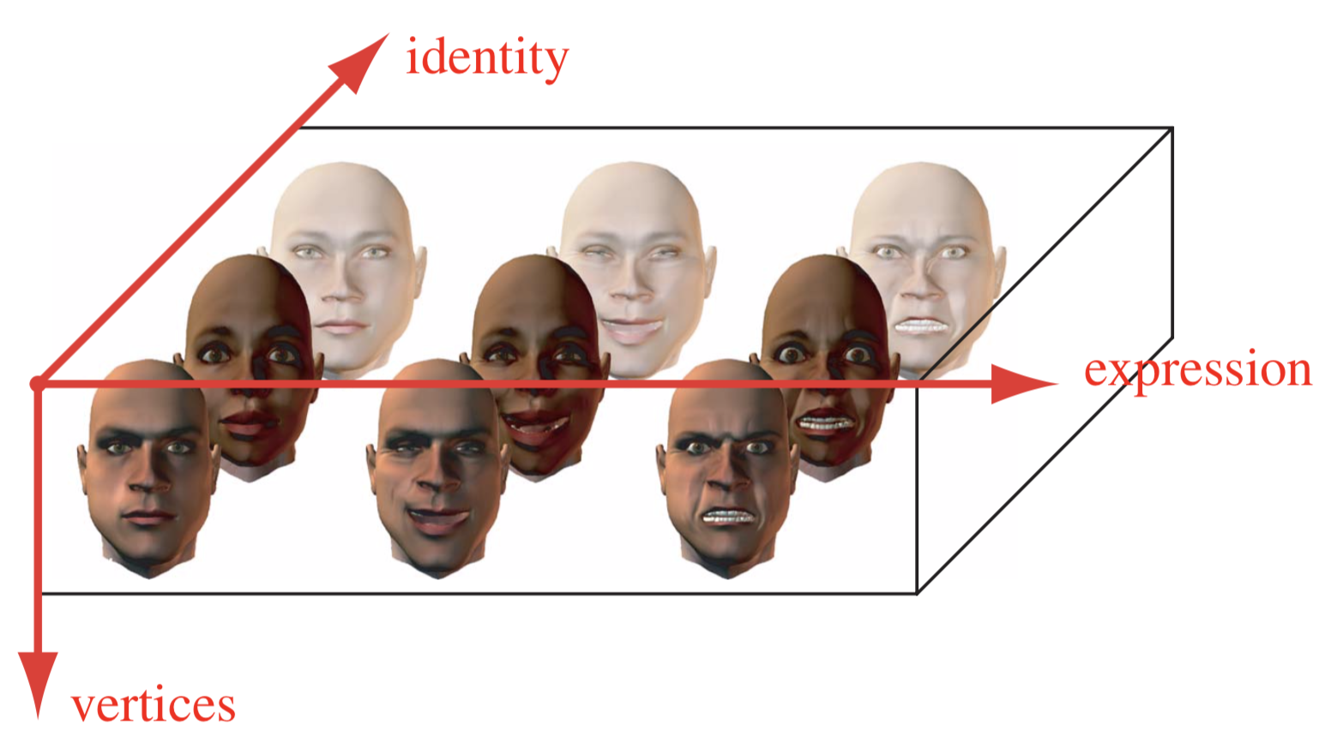
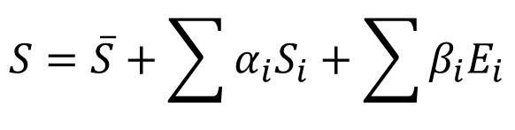
1 Research Background
3D Morphable Model (3DMMs) representation.
$$S=\overline{S}+\sum{α_{i}S_{i}}+\sum{β_{i}E_{i}}$$
Notes:
Currently, the most commonly used method for single-image facial modeling is 3DMM, which stands for 3D Morphable Model.
The representation of 3DMM consists of an average shape, a set of identity blendshapes, and a set of expression blendshapes.

Slide 6
一 Research Background
Advantage
Leveraging learning from extensive facial datasets, 3DMM can capture the major patterns of facial shape and expression, enhancing modeling generalization.
Limited Expressiveness:
3DMM faces challenges in accurately portraying diverse facial expressions, resulting in a restricted capacity to capture the subtleties of nuanced emotional states.
Notes:
表达能力有限：3DMM 在准确表示各种面部表情方面存在局限性，导致在捕捉复杂的细微表情方面面临挑战。

Slide 7
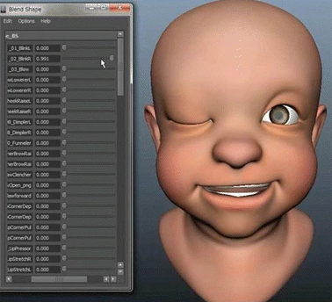
一 Research Background
Advantages
Artist-created blendshapes are crafted by skilled artists, allowing for high accuracy in capturing detailed facial expressions.
Disadvantages
Artist-created blendshapes have limitations in representing diverse faces.
Artist-made blendshapes
Notes:
Another category of blendshapes is manually created by artists.

Slide 8
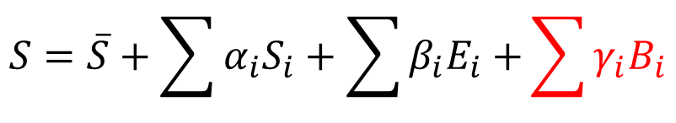
一 Research Background
3DMM + Artist-created blendshapes
$$S=\overline{S}+\sum{α_{i}S_{i}}+\sum{β_{i}E_{i}+}\sum{γ_{i}B_{i}}$$
Notes:
We combine the use of 3D Morphable Models (3DMM) and artist-created blendshapes to represent facial expressions.

Slide 9
2
Method

Slide 10
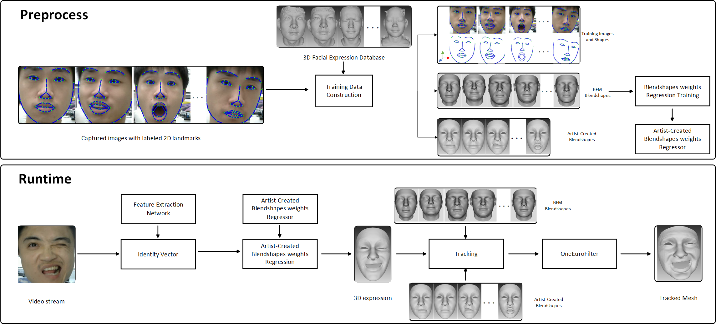
2 Method
Pipeline of our system. Top: preprocessing in the one-time setup step.
Bottom: run-time algorithm.
Notes:
Our work consists of two parts: preprocessing and runtime

Slide 11
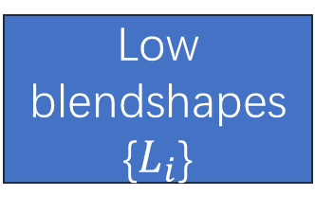
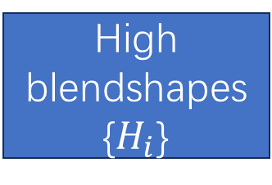
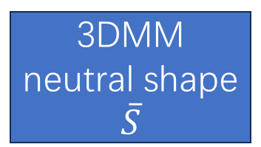
2 Method/preprocess
The artist-created blendshapes are typically designed for low-polygon models and need to be transformed using a deformation transfer method to adapt to the high-polygon structure of 3D Morphable Models (3DMM).
Low blendshapes
{$L_{i}$}
3DMM neutral shape
$$\overline{S}$$
High blendshapes
{$H_{i}$}
Notes:
The artist-created blendshapes are typically designed for low-polygon models and need to be transformed using a deformation transfer method
to adapt to the high-polygon structure of 3D Morphable Models (3DMM).

Slide 12
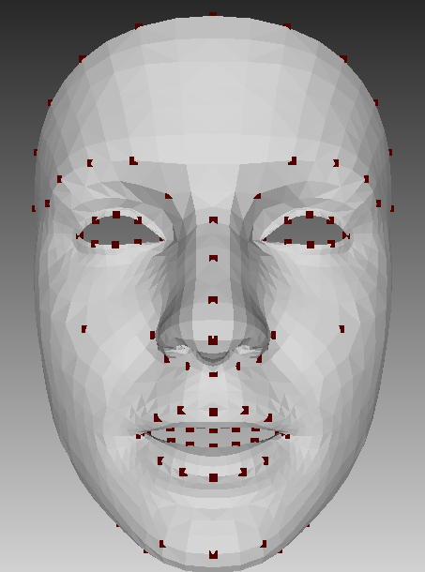
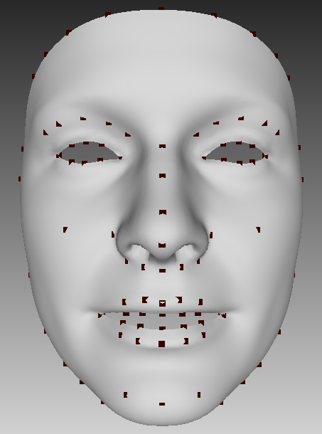
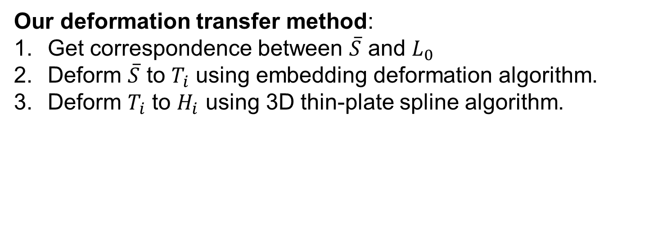

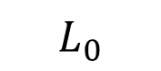
2 Method/preprocess
Our deformation transfer method:
Get correspondence between $\overline{S}$ and $L_{0}$
Deform $\overline{S}$ to $T_{i}$ using embedding deformation algorithm.
Deform $T_{i}$ to $H_{i}$ using 3D thin-plate spline algorithm.
$$L_{0}$$
$$\overline{S}$$
Notes:
The artist-created blendshapes are typically designed for low-polygon models and need to be transformed using a deformation transfer method
to adapt to the high-polygon structure of 3D Morphable Models (3DMM).

Slide 13
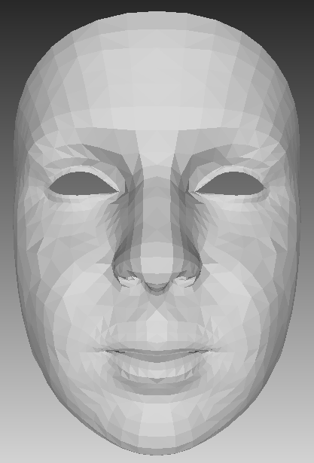
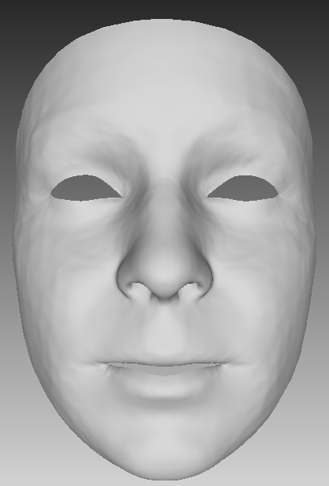
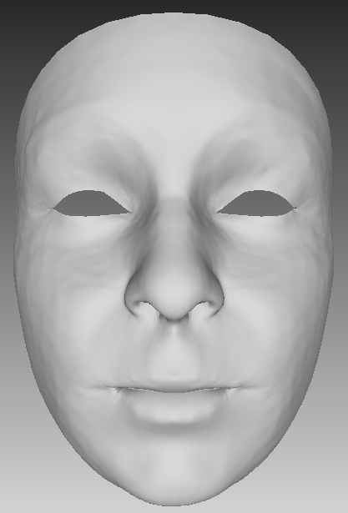
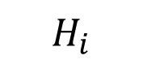
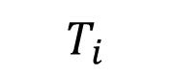
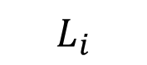
2 Method/preprocess
$$L_{i}$$
$$T_{i}$$
$$H_{i}$$
Notes:
The artist-created blendshapes are typically designed for low-polygon models and need to be transformed using a deformation transfer method
to adapt to the high-polygon structure of 3D Morphable Models (3DMM).

Slide 14
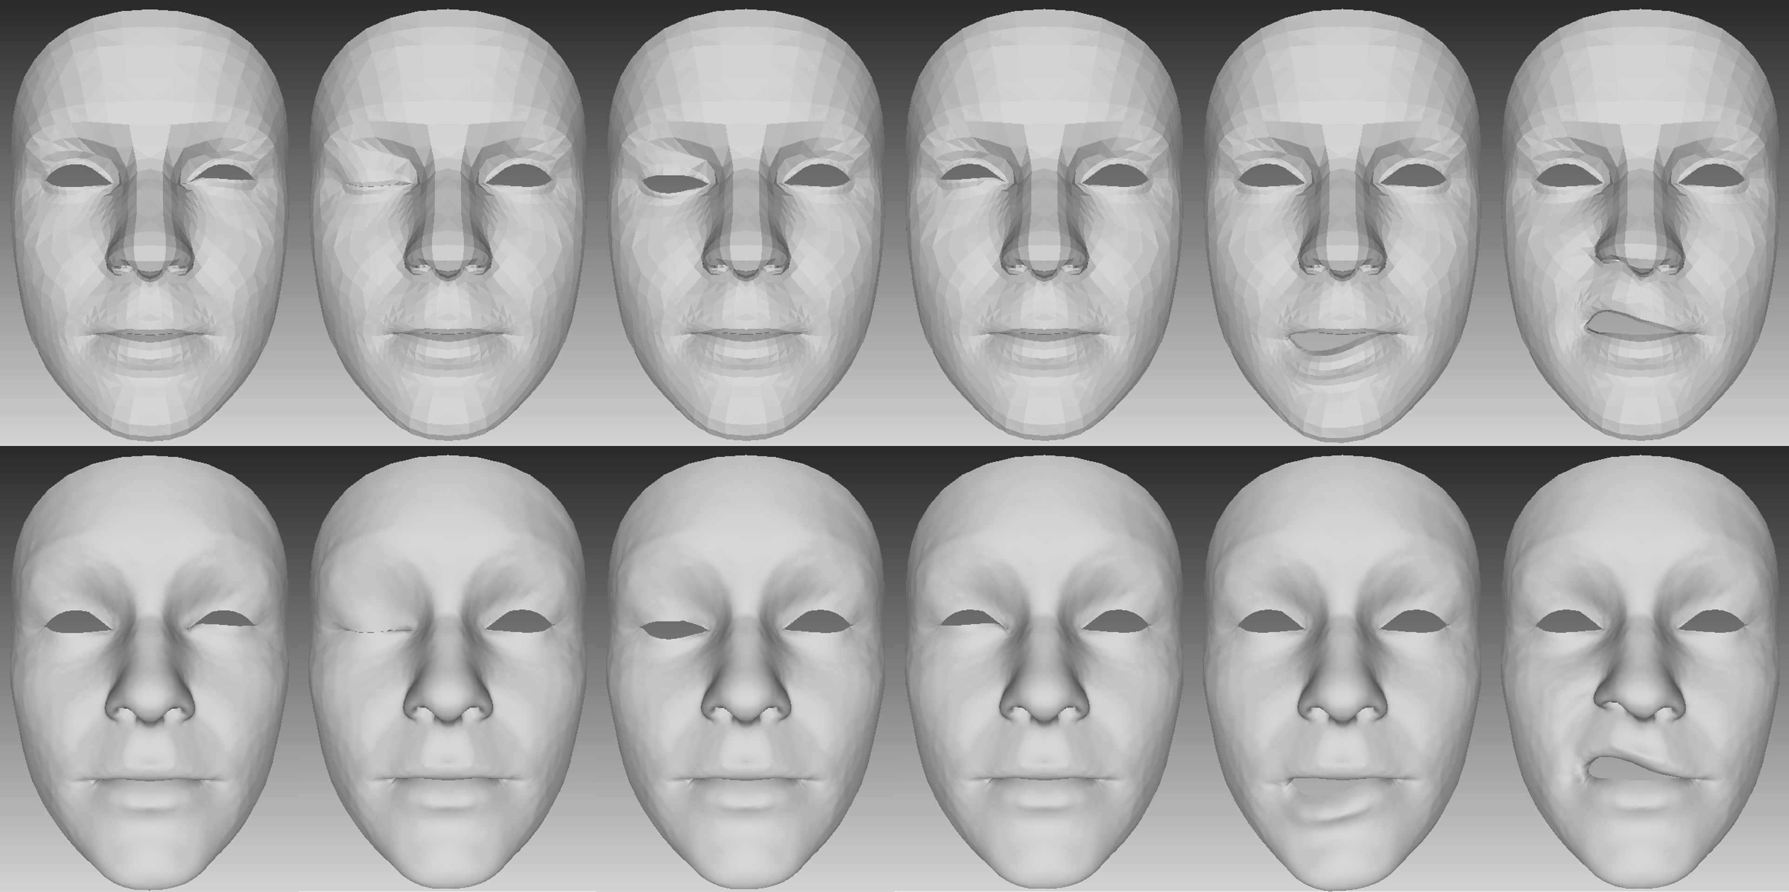
2 Method/preprocess
Low poly blendshapes (top) converted to high poly blendshapes (bottom)
Notes:
The artist-created blendshapes are typically designed for low-polygon models and need to be transformed using a deformation transfer method
to adapt to the high-polygon structure of 3D Morphable Models (3DMM).

Slide 15
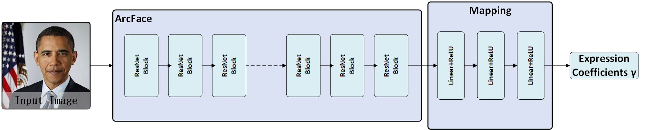

2 Method/preprocess
Expression coefficients $γ$ prediction
Notes:
Our network consists of two parts: resnet and fully connected layer

Slide 16
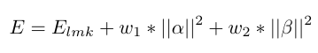
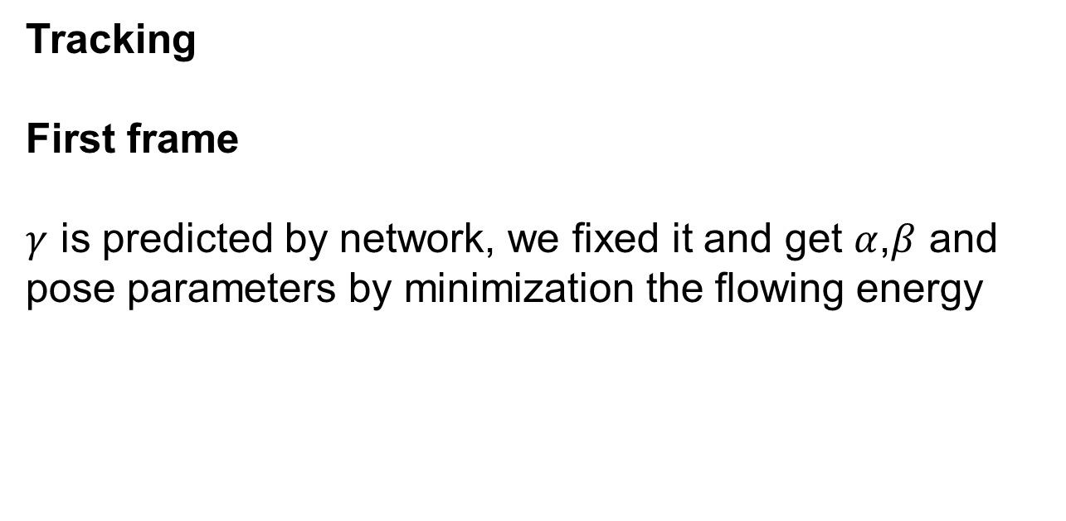
2 Method/runtime
Tracking
First frame
$γ$ is predicted by network, we fixed it and get $α$,$β$ and pose parameters by minimization the flowing energy
Notes:
The artist-created blendshapes are typically designed for low-polygon models and need to be transformed using a deformation transfer method
to adapt to the high-polygon structure of 3D Morphable Models (3DMM).

Slide 17
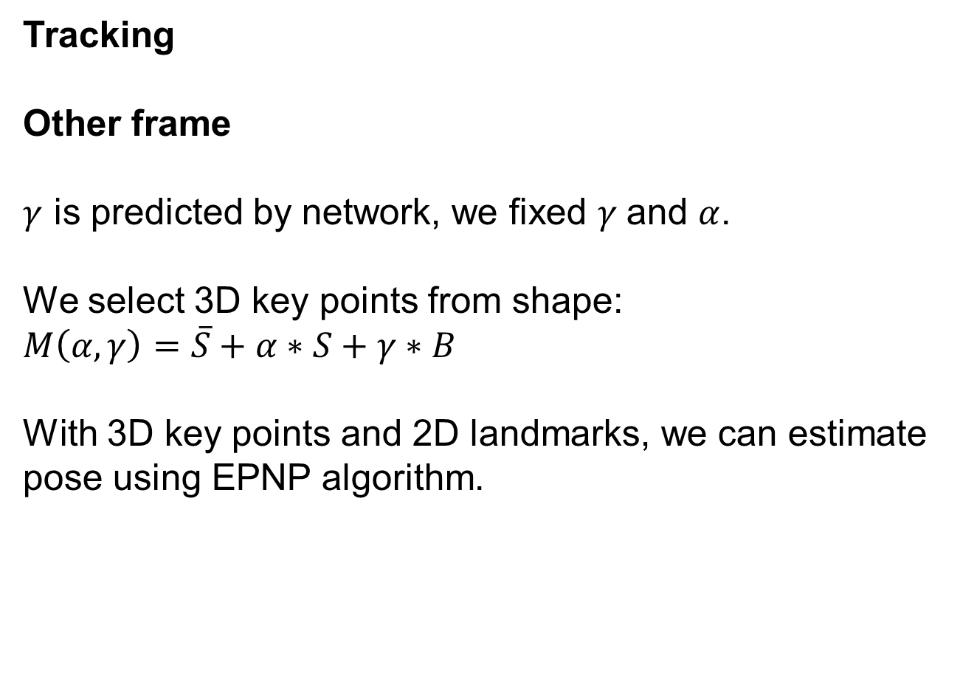
2 Method/runtime
Tracking
Other frame
$γ$ is predicted by network, we fixed $γ$and $α$.
We select 3D key points from shape:
$$M\left(α,γ\right)=\overline{S}+α∗S+γ∗B$$
With 3D key points and 2D landmarks, we can estimate pose using EPNP algorithm.
Notes:
The artist-created blendshapes are typically designed for low-polygon models and need to be transformed using a deformation transfer method
to adapt to the high-polygon structure of 3D Morphable Models (3DMM).

Slide 18
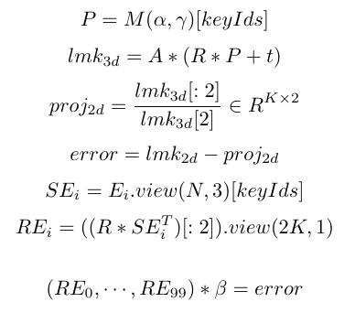
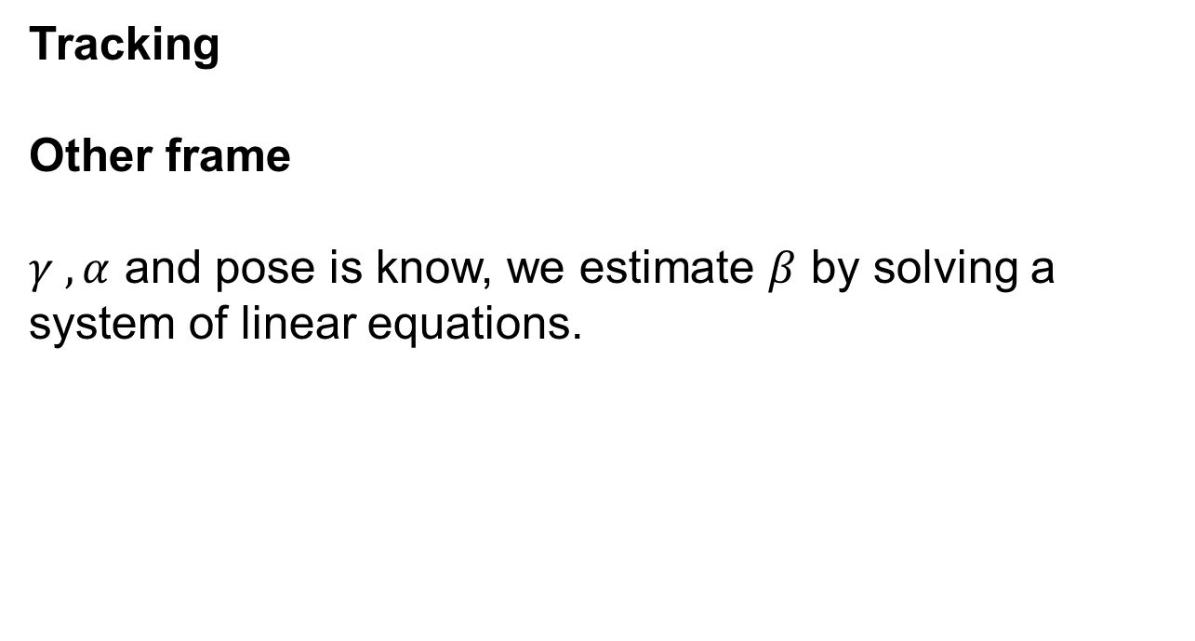
2 Method/runtime
Tracking
Other frame
$γ ,α$ and pose is know, we estimate $β$ by solving a system of linear equations.
Notes:
The artist-created blendshapes are typically designed for low-polygon models and need to be transformed using a deformation transfer method
to adapt to the high-polygon structure of 3D Morphable Models (3DMM).

Slide 19
3
Experiments

Slide 20
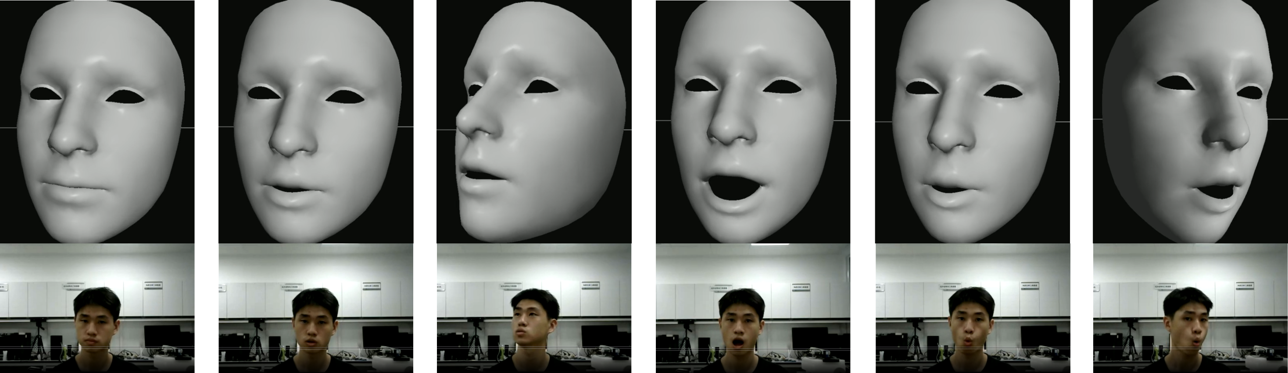
3 Experiments
Real-time reconstruction of animated 3D models of the face

Slide 21
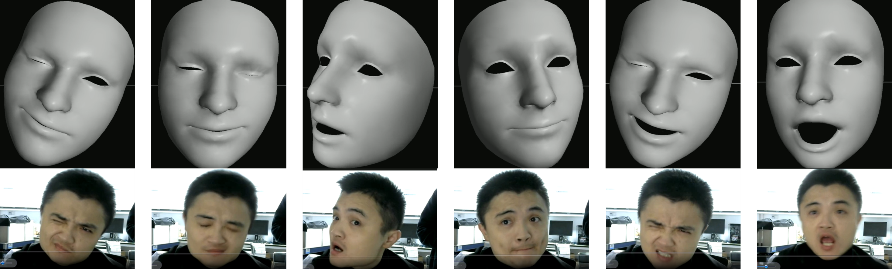
3 Experiments
Real-time reconstruction of animated 3D models of the face

Slide 22
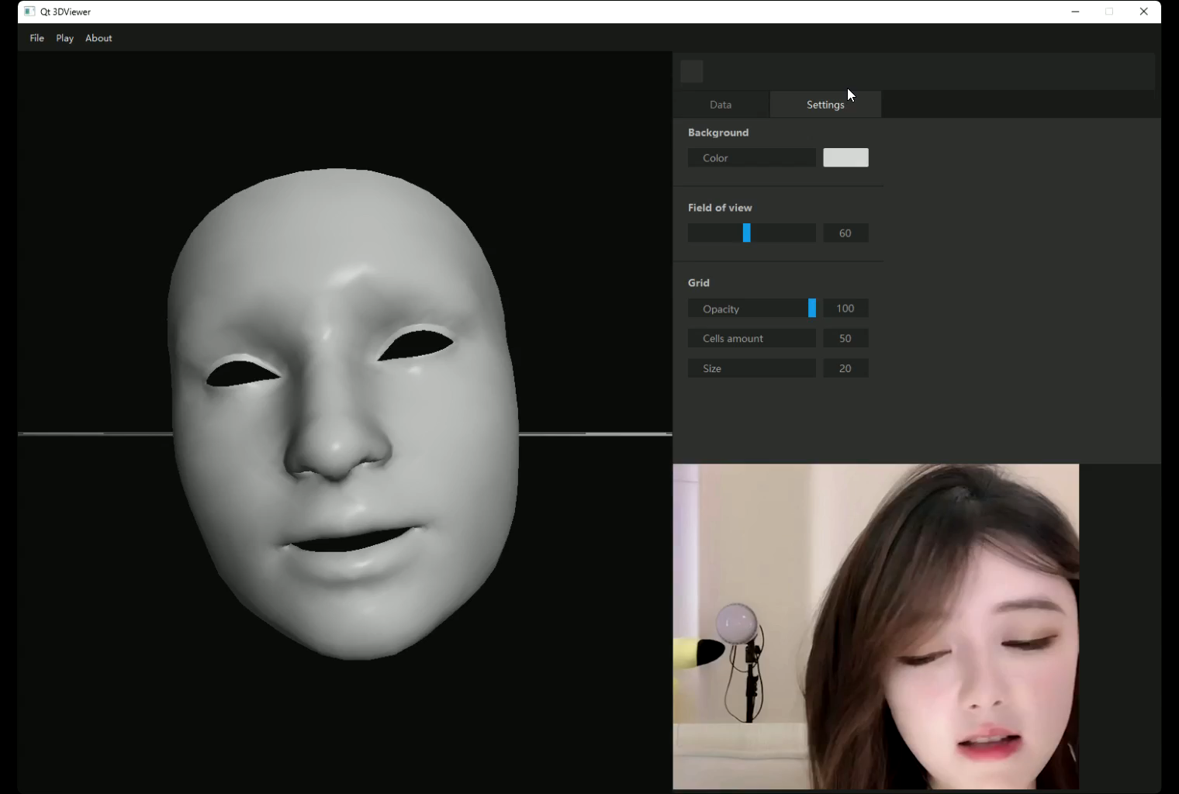
3 Experiments
Experiments on offline video.

Slide 23
谢谢大家宝贵时间
欢迎大家批评指正
THANKS

